Slide 1
Towards Deep Learning Models Resistant to Adversarial Attacks
https://arxiv.org/pdf/1706.06083.pdf
Aleksander Madry, Aleksandar Makelov, Ludwig Schmidt, Dimitris Tsipras, Adrian Vladu
Presentation by: Eldad Peretz

Slide 2
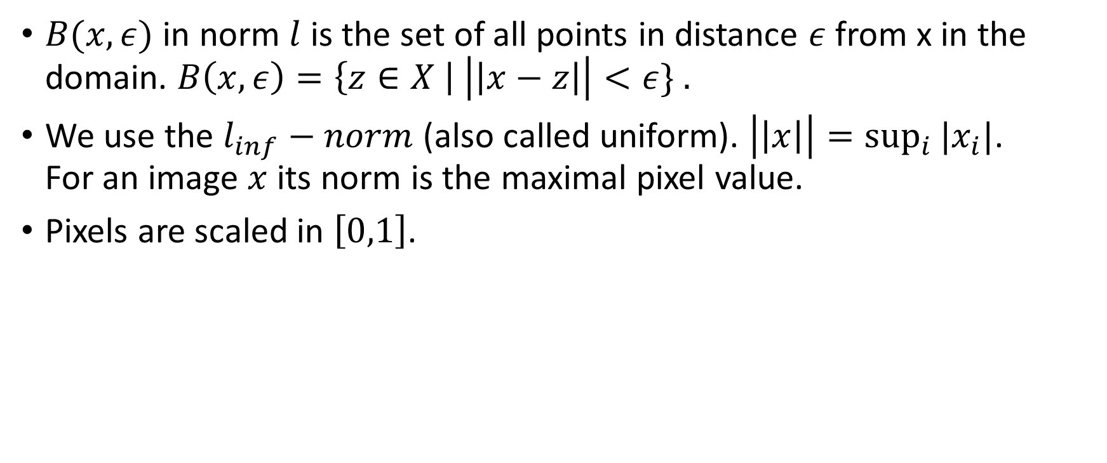
Notations
$B(x, ε)$ in norm $l$ is the set of all points in distance $ε$ from x in the domain. $B\left(x, ε\right)=\left\{z∈X \right| \left|\left|x−z\right|\right|<ε\} .$
We use the $l_{inf}−norm$ (also called uniform). $\left|\left|x\right|\right|=\sup_{i}{{|x}_{i}|}$. For an image $x$ its norm is the maximal pixel value.
Pixels are scaled in $\left[0,1\right]$.

Slide 3
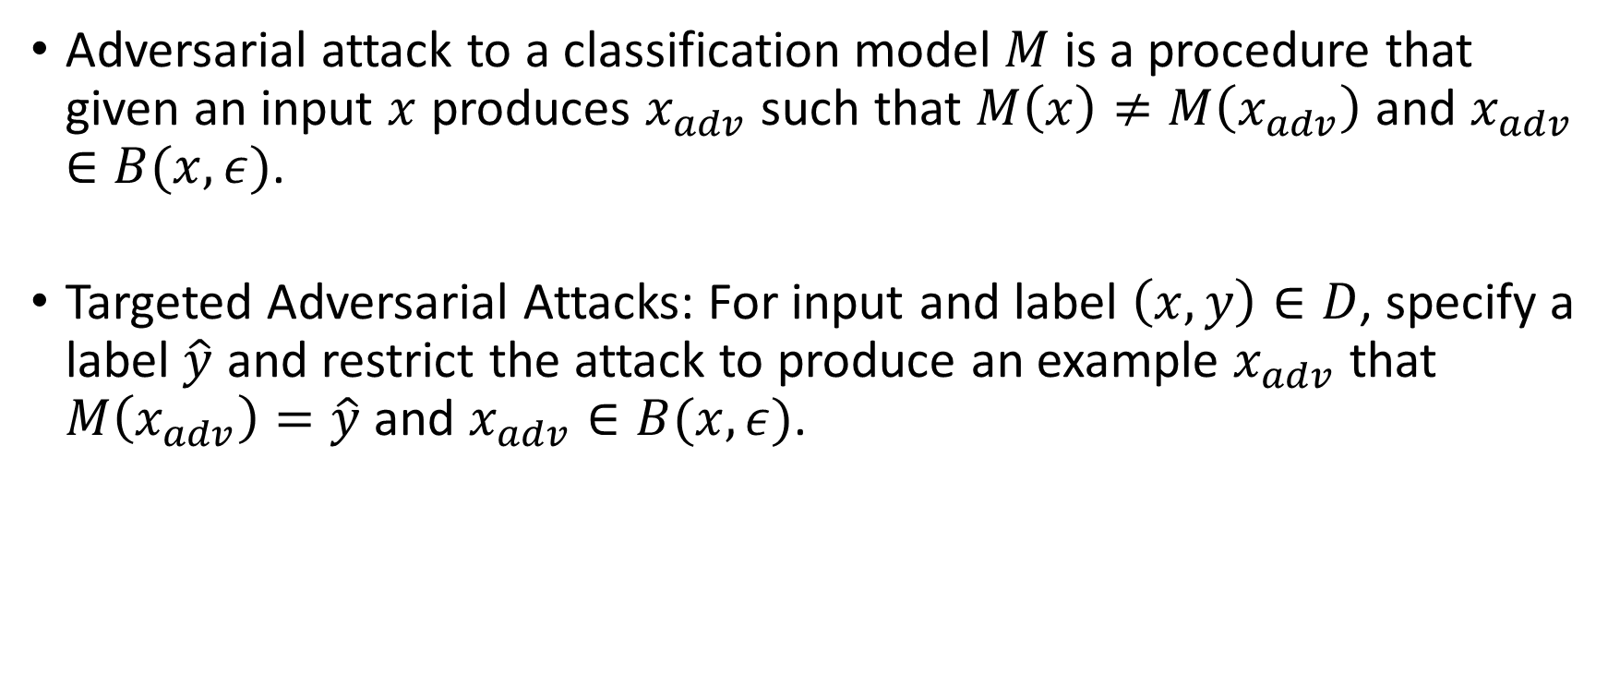
Adversarial Attacks
Adversarial attack to a classification model $M$ is a procedure that given an input $x$ produces $x_{adv}$ such that $M\left(x\right)≠M\left(x_{adv}\right)$ and $x_{adv}∈B(x, ε)$.
Targeted Adversarial Attacks: For input and label $\left(x,y\right)∈D$, specify a label $\hat{y}$ and restrict the attack to produce an example $x_{adv}$ that $M\left(x_{adv}\right)=\hat{y}$ and $x_{adv}∈B(x, ε)$.

Slide 4
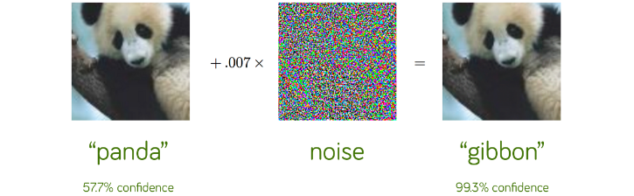

Example
In computer vision, for small $ε$ the changes are almost undetectable to the human eye. Here $ε=0.007$.

Slide 5
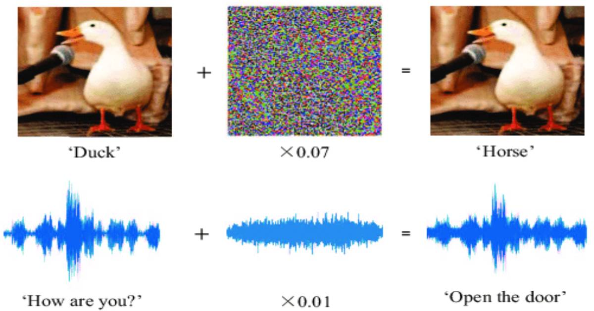
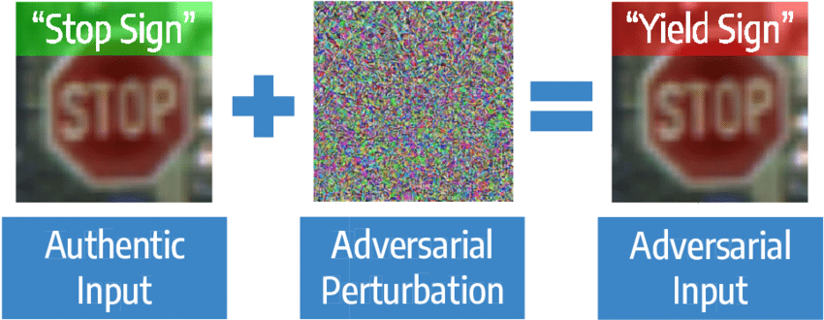

Slide 6

Adversarial examples in NLP?

Slide 7

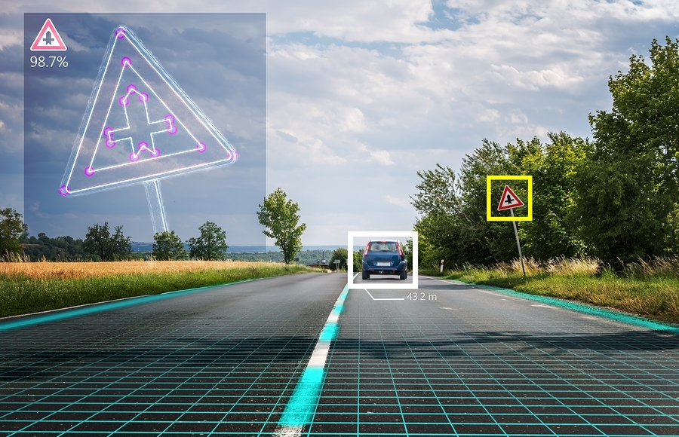

https://arxiv.org/ftp/arxiv/papers/2001/2001.11137.pdf
https://arxiv.org/pdf/1707.08945.pdf
https://arxiv.org/pdf/1911.01840.pdf

Slide 8
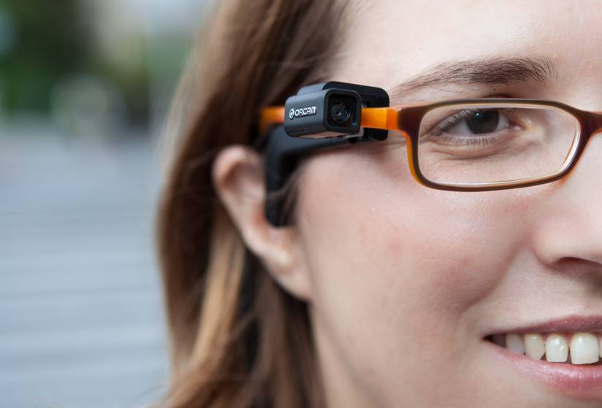

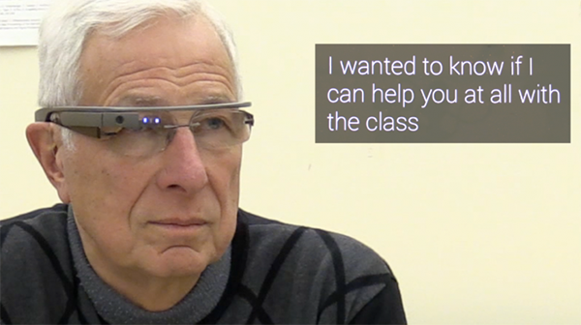
https://www.youtube.com/watch?time_continue=39&v=Z9f4Evs34R8&feature=emb_title
https://arxiv.org/pdf/1801.02950.pdf
https://arxiv.org/pdf/1811.01312.pdf

Slide 9
Attacks Settings
White box setting: the adversary has full access to the trained model. Hence it can calculate accurate gradients of the loss w.r.t. the input and use it to generate adversarial attacks as we show next.
First order setting: the adversary can use only first-order derivatives of the loss w.r.t. the input.
Black box setting: the adversary has no knowledge or access to the model. A common approach is to use approximate gradient instead the accurate gradient.

Slide 10
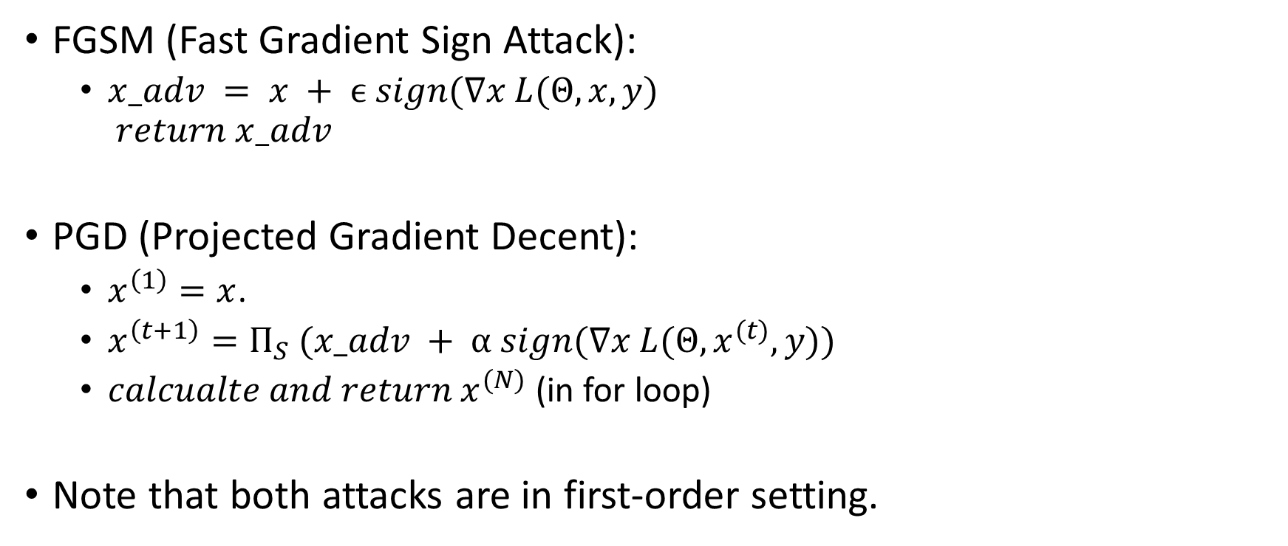
The Attacks
FGSM (Fast Gradient Sign Attack):
$x_adv = x + ϵ sign(∇x L(Θ, x, y)$ $return x_adv$
PGD (Projected Gradient Decent):
$x^{\left(1\right)}=x$.
$x^{\left(t+1\right)}=Π_{S} (x_adv + α sign(∇x L(Θ, x^{(t)}, y))$
$calcualte and return x^{(N)}$ (in for loop)
Note that both attacks are in first-order setting.

Slide 11
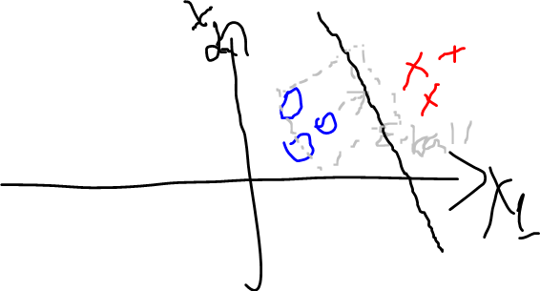
FGSM is optimal for linear binary classification
The shortest path to pass the decision boundary is the orthogonal direction of the linear decision boundary towards the correct direction.
$∇_{x}L\left(wx, y\right)∝yw$. yw is the optimal direction as we see.

Slide 12
Transferred Attacks
Let's imagine the following scenario:
There is a secret model we want to attack.
We can use a black-box attacking method, but let’s say we want more - we want to apply a white box attack.
How can we do it?
Idea:
Train model to the same task independently. Called a surrogate model.
Apply the white box attack on the surrogate model.
Use it to attack the target model.
Works better if we know the target model architecture.
We see next the relation of this to target capacity.

Slide 13
Paper Contributions
Formulates the optimization problem of defending from adversarial attacks.
Introduces and analyze a procedure to create models that are resistant to first order adversarial attacks.
The procedure is universal – it defenses from any first order attack. To prove that, the authors show that PGD is universal attack – which is another contribution (discussed in next slide).
The relation between model capacity and robustness.
An analysis of adversarial trained CNN for MNIST (Appendix C).

Slide 14
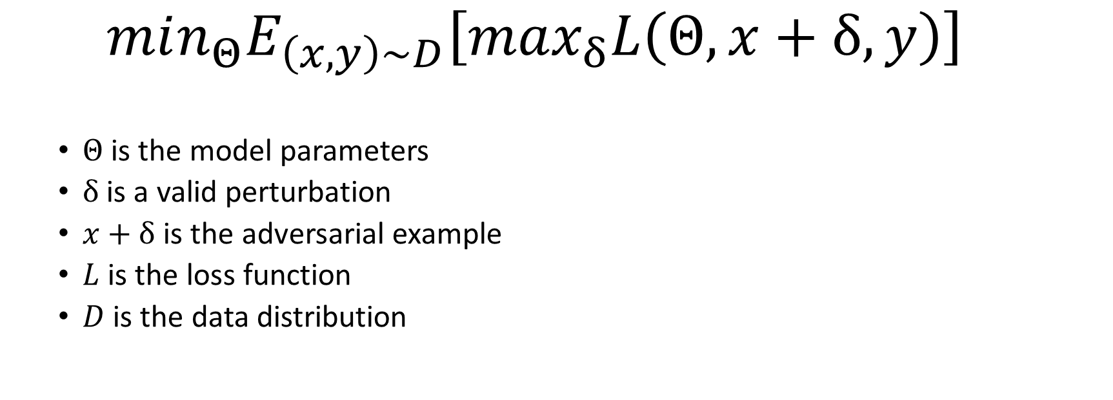
Formalizing the optimization problem
$min_{Θ}E_{\left(x,y\right)\sim D}\left[max_{δ}L\left(Θ,x+δ,y\right)\right]$
$Θ$ is the model parameters
$δ$ is a valid perturbation
$x+δ$ is the adversarial example
$L$ is the loss function
$D$ is the data distribution

Slide 15
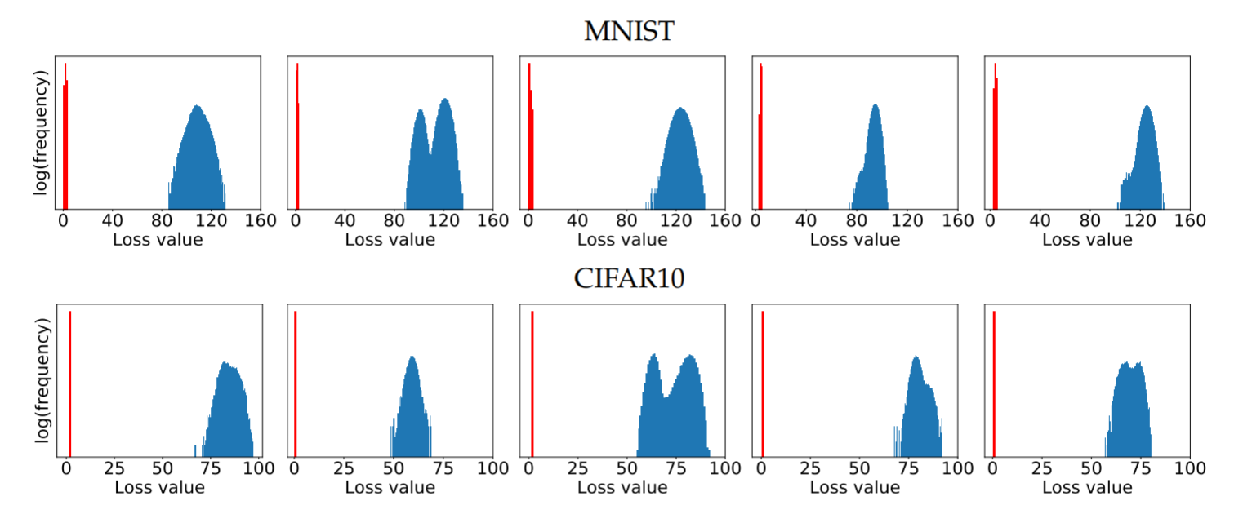
PGD is universal attack
It means that PGD solves the inner problem better than any other first-order attack.
No outliers. Almost same value for any execution.
The blue is distribution of the PGD values for the original trained. The red is for the adversarial trained.

Slide 16
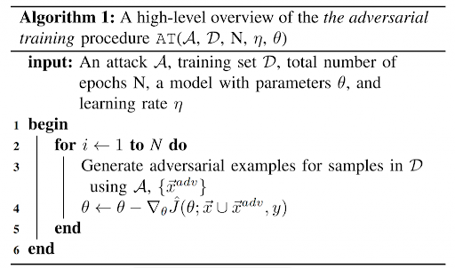
The Method – Adversarial Training
Notes:
In practice (also in the paper) it is done in batches. It doesn’t change the analysis.
http://precog.iiitd.edu.in/blog/2019/03/13/hardening-deep-neural-networks-via-adversarial-model-cascades/

Slide 17
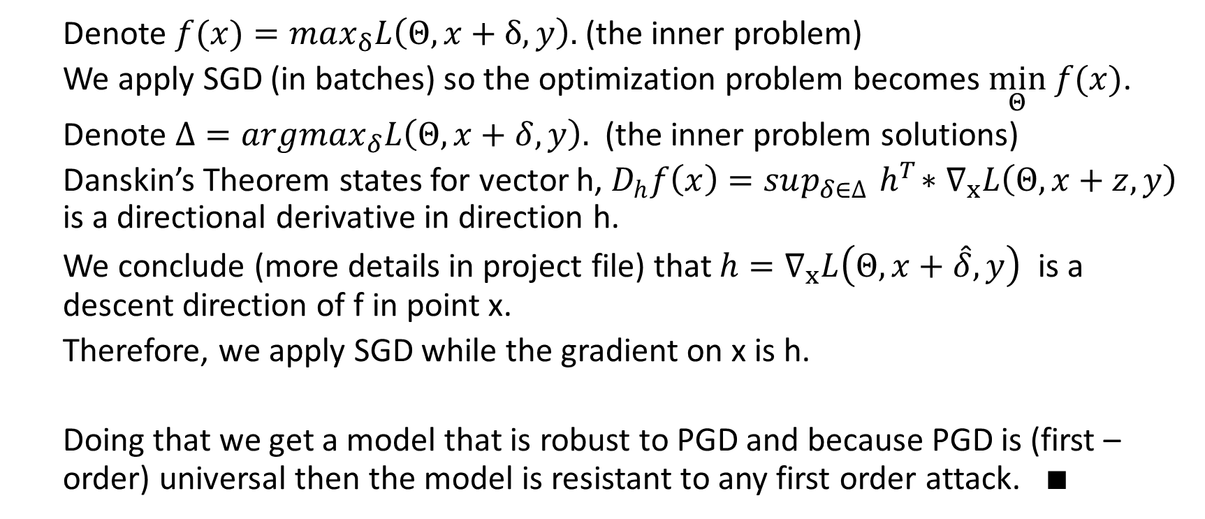
Short Analysis
Denote $f(x)=max_{δ}L\left(Θ,x+δ,y\right).$ (the inner problem)
We apply SGD (in batches) so the optimization problem becomes $\min_{Θ} f(x)$.
Denote $Δ=argmax_{δ}L\left(Θ, x+δ, y\right).$ (the inner problem solutions)
Danskin’s Theorem states for vector h, $D_{h}f\left(x\right)=sup_{δ∈∆}{ h}^{T}∗∇_{x}L\left(Θ, x+z, y\right)$ is a directional derivative in direction h.
We conclude (more details in project file) that $h=∇_{x}L\left(Θ, x+\hat{δ}, y\right)$ is a descent direction of f in point x.
Therefore, we apply SGD while the gradient on x is h.
Doing that we get a model that is robust to PGD and because PGD is (first –order) universal then the model is resistant to any first order attack. $∎$

Slide 18
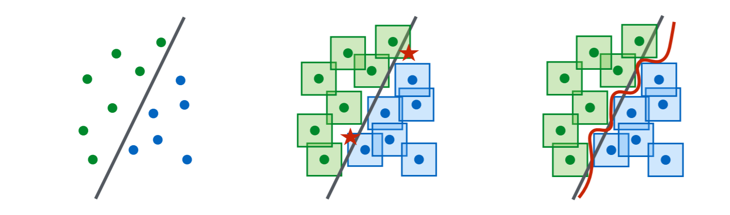
Capacity and Robustness

Slide 19
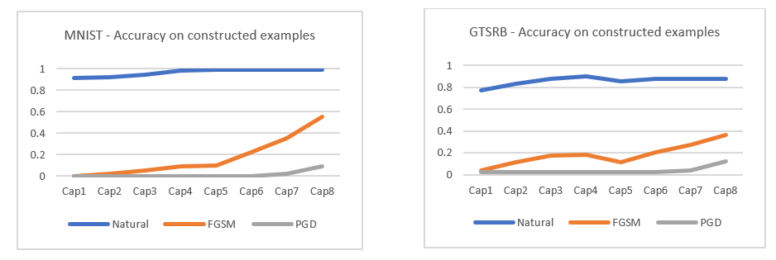
1) Capacity alone helps

Slide 20
2) Low capacity models may underfit while training with PGD adversary.
The tradeoff between the accuracy on natural examples and adversarial examples which low capacity model can’t be solved by low capacity models.

Slide 21
3) The value of the saddle point problem decreases as we increase the capacity
By the same experiment as 2:

Slide 22
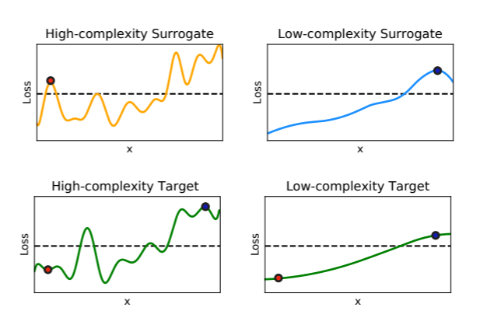
4) More capacity and stronger adversaries decrease transferability

Slide 23
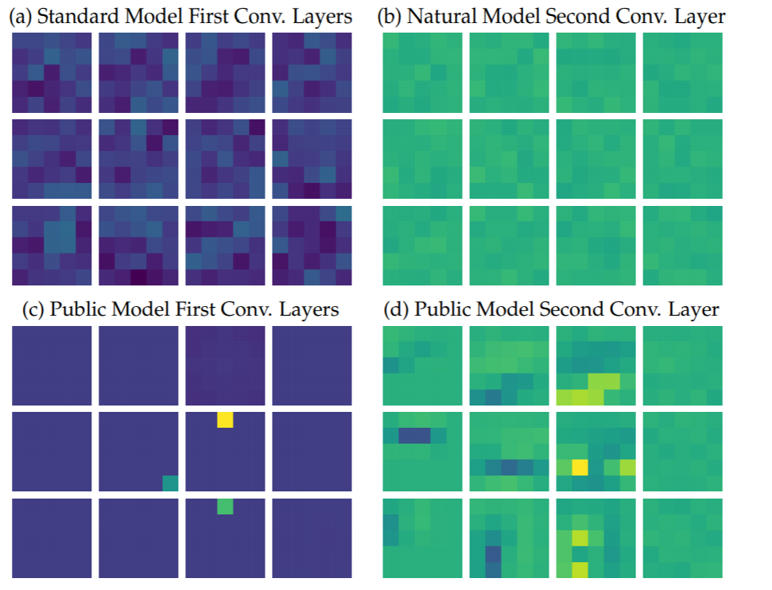
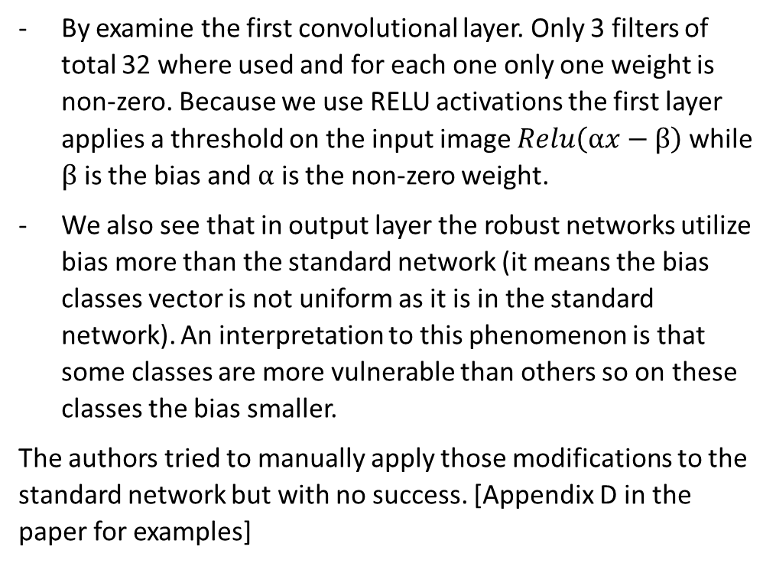
MNIST Inspection
By examine the first convolutional layer. Only 3 filters of total 32 where used and for each one only one weight is non-zero. Because we use RELU activations the first layer applies a threshold on the input image $Relu\left(αx−β\right)$ while $β$ is the bias and $α$ is the non-zero weight.
We also see that in output layer the robust networks utilize bias more than the standard network (it means the bias classes vector is not uniform as it is in the standard network). An interpretation to this phenomenon is that some classes are more vulnerable than others so on these classes the bias smaller.
The authors tried to manually apply those modifications to the standard network but with no success. [Appendix D in the paper for examples]

Slide 25
Related Work
Query-limited setting - https://arxiv.org/pdf/1804.08598.pdf
Label Only setting - https://arxiv.org/pdf/2006.12792.pdf [RayS]
“Improving the Adversarial Robustness of Transfer Learning via Noisy Feature Distillation” - https://arxiv.org/pdf/2002.02998.pdf
“Adversarial Training Can Hurt Generalization” - https://openreview.net/pdf?id=SyxM3J256E
“Automatically Evading Classifiers” - https://evademl.org/docs/evademl.pdf. [As example to a black box attack that doesn’t use gradients – based on genetic search. Tested on malware detection case-study]

Slide 26
Challenges
The writers established a competition to fool the robust network they build on MNIST and CIFAR on both black-box and white-box. We see that during the last 2-3 years that the competition exists, no one succeed to decrease the accuracy on black box to more than 92% and in white box to more than 88%.

Slide 27
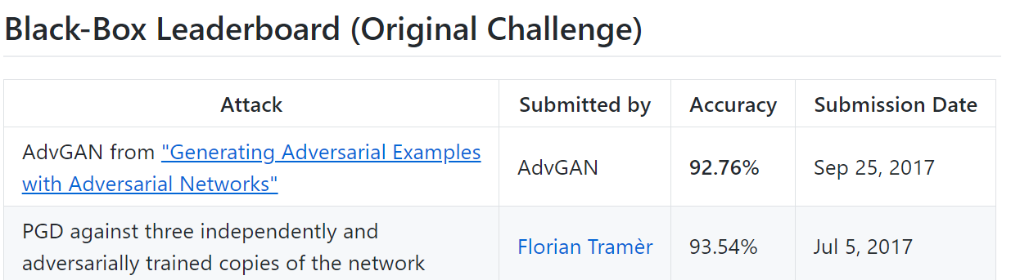
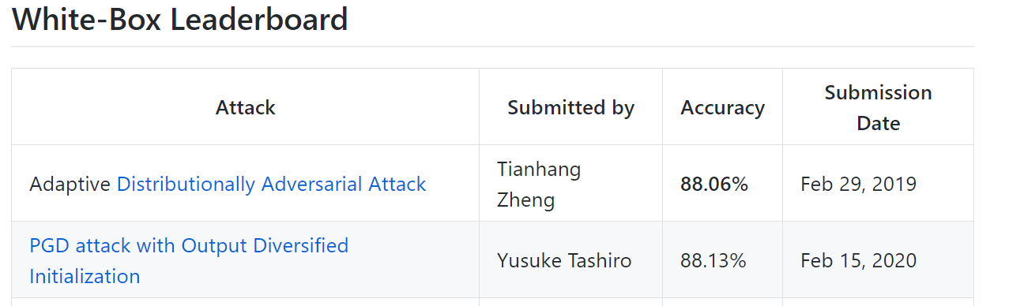
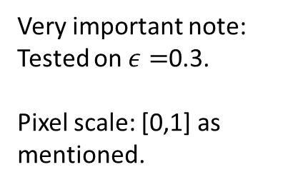
Challenge on MNIST
Very important note:
Tested on $ε=$0.3.
Pixel scale: [0,1] as mentioned.
https://github.com/MadryLab/mnist_challenge

Slide 28
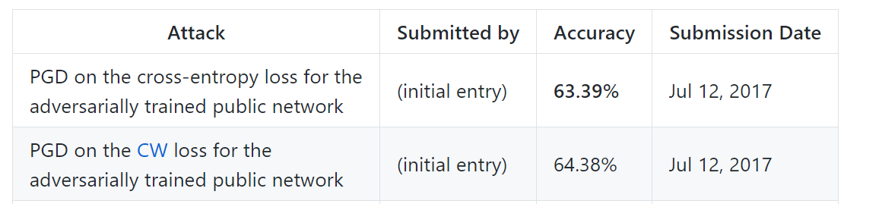
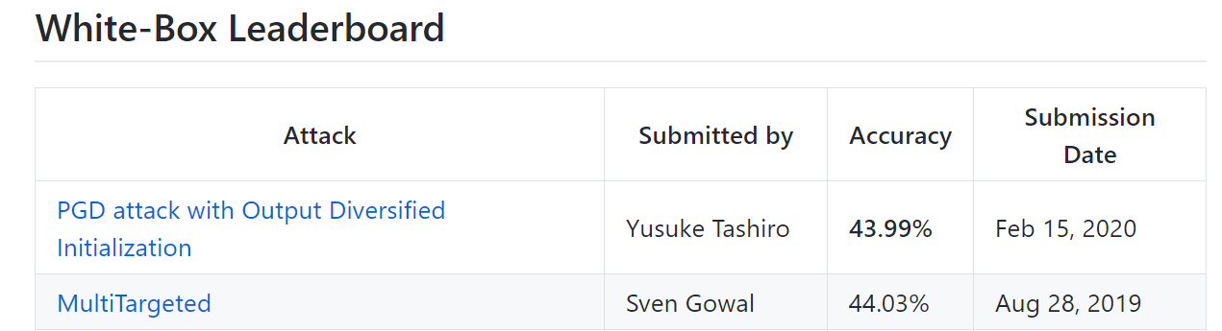
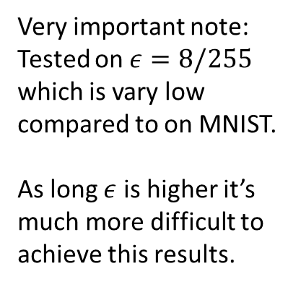
Challenge on CIFAR10
Very important note:
Tested on $ε=8/255$ which is vary low compared to on MNIST.
As long $ε$ is higher it’s much more difficult to achieve this results.
https://github.com/MadryLab/cifar10_challenge

Slide 29
My Experiments
Done on both MNIST and GTSRB (German Traffic Sign Recognition).

Slide 30
Experiment 1
CNN default training (measured on Test)
 | Accuracy on Natural examples | Accuracy on PGD adversarial examples | Accuracy on FGSM adversarial examples
GTSRB | 99% | 10% | 3%
MNIST | 99% | 2% | 17%

Slide 31
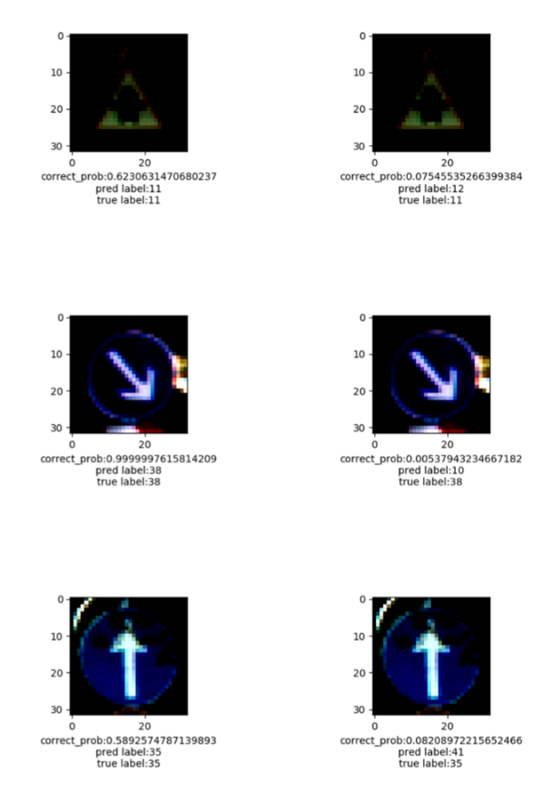
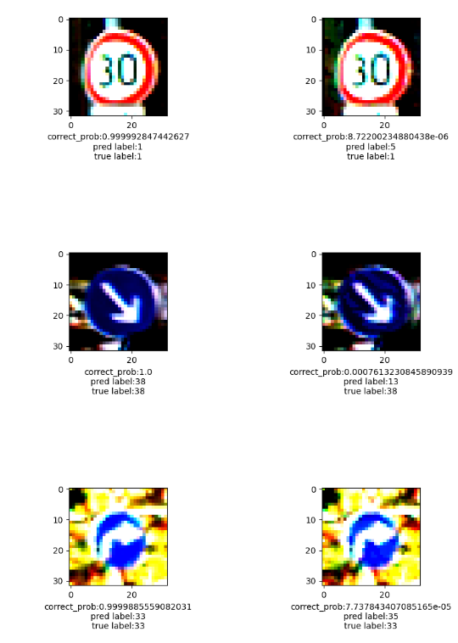
Examples
FGSM
PGD

Slide 32
Experiment 2
CNN adversarial training with FGSM (measured on Test)
 | Accuracy on Natural examples | Accuracy on PGD adversarial examples | Accuracy on FGSM adversarial examples
GTSRB
MNIST
CNN adversarial training with PGD (measured on Test)
 | Accuracy on Natural examples | Accuracy on PGD adversarial examples | Accuracy on FGSM adversarial examples
GTSRB | 64 | 45 | 56
MNIST | 98% | 95% | 97%

Slide 33
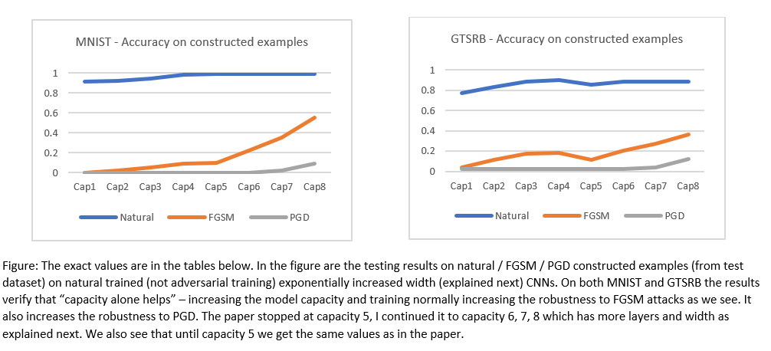
Experiment 3

Slide 34
Experiment 4

Slide 35
Thanks for Listening ☺

